Slide 1
CPT-S 415
Big Data
Yinghui Wu
EME B45

Slide 2
CPT-S 415
Big Data
NewSQL databases
In-memory DBMS
Notes:
Object.

Slide 3
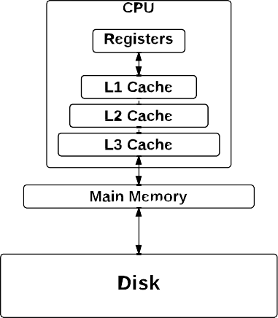

Recall Computer Architecture
I/O cost
Data taken from [Hennessy and Patterson, 2012]

Slide 4
Disk-oriented DBMS

Slide 5
Disk- Oriented DBMS
5
The primary storage location of the database is on non-volatile storage (e.g., HDD, SSD).
→ The database is organized as a set of fixed-length blocks called slotted pages.
The system uses an in-memory buffer pool to cache blocks fetched from disk.
→ Its job is to manage the movement of those blocks back and forth between disk and memory.

Slide 6
Page request
Page Requests from Higher Levels
BUFFER POOL
disk page
free frame
MAIN MEMORY
DISK
Choice of frame dictated
by replacement policy
DB
Data must be in RAM for DBMS to operate on it!
Table of <frame#, pageId> pairs is maintained.
Notes:
4
To understand the role of buffer manager, consider the following example.
Suppose database contains 1,000,000 pages, but only 1000 pages of main memory are available for holding data. Consider a query that requires a scan of the entire file. Since all the data cannot reside in the main memory at one time, the DBMS must bring pages into main memory as they are needed, and in the process, decide which existing page in main memory to replace to make space for the new page. The policy used to decide which page to replace is called the replacement policy.
Buffer pool – collection of available main memory pages or frames.
Buffer manager maintains a table of <frame#, pageID>

Slide 7
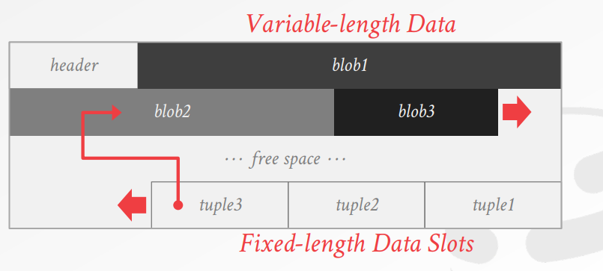
A page

Slide 8
Buffer Pool Management
When Query access a page:
  DBMS checks if page is in memory
    No – retrieve from disk and copy into frame of buffer pool
      No free frames: find a page to evict
      Dirty page evicted – write back to disk
    Yes – translate on-disk addresses to in-memory addresses

Slide 9
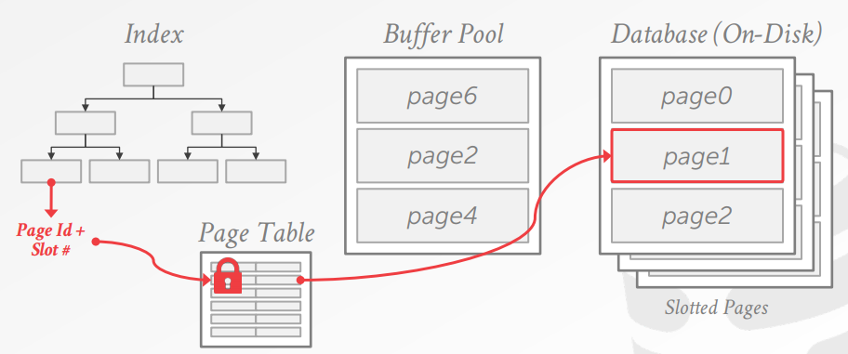
Example: page request

Slide 10
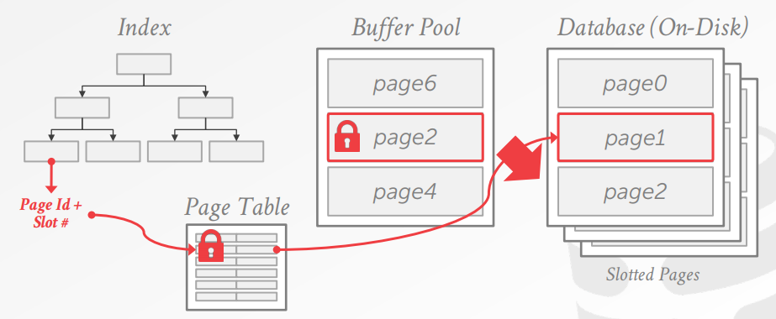
Example: page request

Slide 11

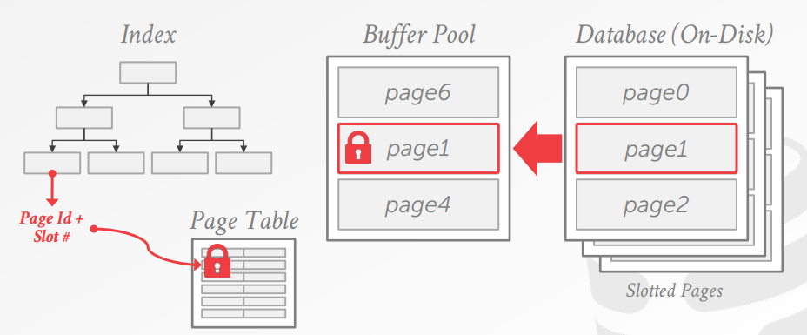
Example: page request

Slide 12
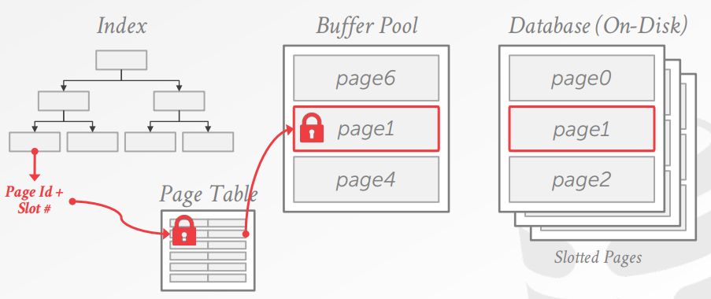
Example: page request

Slide 13
Overhead
Buffer pool: Each tuple access needs to go through buffer pool management regardless of whether the data will always be in memory
  Translate tuple record id to memory location
  Pin pages to make sure they are not swapped to disk
Concurrency control
  ACID guarantee: set locks and latches
Logging & recovery
  “steal” + “no-force” buffer pool policy
  Log contains before and after images of modified record.

Slide 14
Overhead
Buffer pool: Each tuple access needs to go through buffer pool management regardless of whether the data will always be in memory
  Translate tuple record id to memory location
  Pin pages to make sure they are not swapped to disk
Concurrency control
  ACID guarantee: set locks and latches
Logging & recovery
  “steal” + “no-force” buffer pool policy
  Log contains before and after images of modified record.

Slide 15
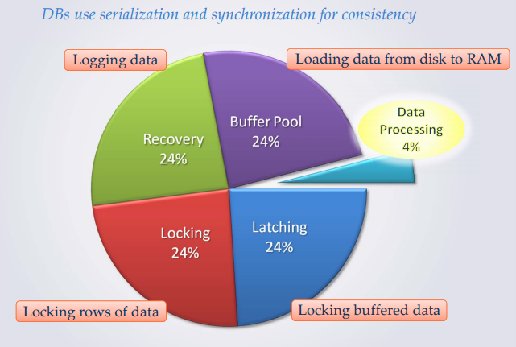
Traditional DBMS overheads
“Removing those overheads and running the database in main memory would yield orders of magnitude improvements in database performance”
Notes:
Death by a thousand paper cut.

Slide 16
NewSQL design principles
SQL + ACID + performance and scalability through modern innovative software architecture
Principle 1: minimizing or stay away from locking
Principle 2: rely on main memory
Principle 3: try to avoid latching
Principle 4: cheaper solutions for HA

Slide 17
In-memory databases

Slide 18
Recall Computer Architecture
Cache cost –
In-memory
store
Data taken from [Hennessy and Patterson, 2012]

Slide 19
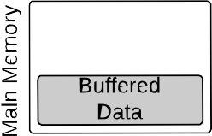
Disk-based vs. Main-Memory DBMS
7/116

Slide 20
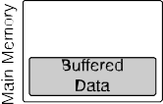
Disk-based vs. Main-Memory DBMS (2)
ATTENTION: Main-memory storage != No Durability
→ ACID properties have to be guaranteed
→ However, there are new ways of guaranteeing it, such as a second machine in hot standby

Slide 21
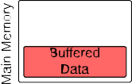
Disk-based vs. Main-Memory DBMS (3)
Having the database in main memory allows us to remove buffer manager and paging
→ Remove level of indirection
→ Results in better performance

Slide 22
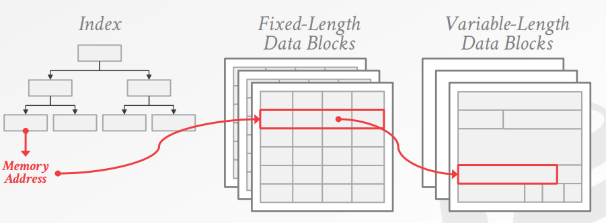
In-memory data organization

Slide 23
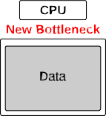
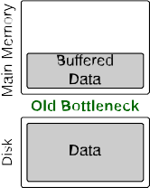
Disk-based vs. Main-Memory DBMS (4)
Disk bottleneck is removed as database is kept in main memory
→ Access to main memory becomes new bottleneck

Slide 24
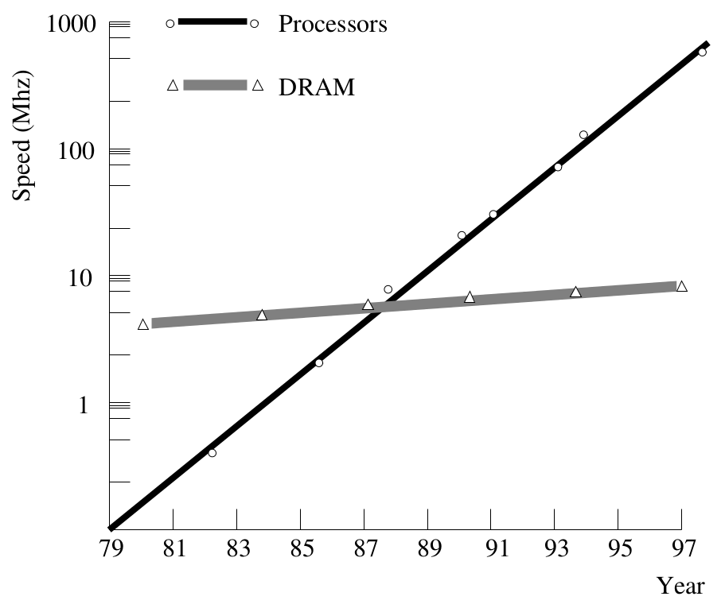
The New Bottleneck: Memory Access
Accessing main-memory is much more expensive than accessing CPU registers.
→ Is main-memory the new disk?
Picture taken from [Manegold et al., 2000]

Slide 25
New bottleneck
When I/O is no longer the bottleneck…
  Locking/latching
  Cache-line misses
  Data movement

Slide 26
Rethink the Architecture of DBMSs
Even if the complete database fits in main memory, there are significant overheads of traditional DBMSs:
  Many function calls → stack manipulation overhead + instruction-cache misses
  Adverse memory access → data-cache misses
→ Be aware of the caches!

Slide 27
Cache awareness

Slide 28
Principle of Locality
Caches take advantage of the principle of locality.
  The hot set of data often fits into caches.
  90 % execution time spent in 10 % of the code.
Spatial Locality:
  Related data is often spatially close.
  Code often contains loops.
Temporal Locality:
  Programs tend to re-use data frequently.
  Code may call a function repeatedly, even if it is not spatially close.

Slide 29
CPU Cache Internals
To guarantee speed, the overhead of caching must be kept reasonable.
Organize cache in cache lines.
Only load/evict full cache lines.
Typical cache line size: 64 bytes.
0 1 2 3 4 5 6 7
line size
cache line
The organization in cache lines is consistent with the principle of (spatial) locality.

Slide 30
Memory Access
On every memory access, the CPU checks if the respective cache line is already cached.
Cache Hit:
Read data directly from the cache.
No need to access lower-level memory.
Cache Miss:
Read full cache line from lower-level memory.
Evict some cached block and replace it by the newly read cache line.
CPU stalls until data becomes available.
Modern CPUs support out-of-order execution and several in-flight cache misses.

Slide 31
Block Placement: Direct-Mapped Cache
In a direct-mapped cache, a block has only one place it can
appear in the cache.
0 1 2 3 4 5 6 7
Much simpler to implement.
Easier to make fast.
Increases the chance of conflicts.
place block 12 in cache line 4 (4 = 12 mod 8)
1 1 1 1 1 1 1 1 1 1 2 2 2 2 2 2 2 2 2 2 3 3
0 1 2 3 4 5 6 7 8 9 0 1 2 3 4 5 6 7 8 9 0 1 2 3 4 5 6 7 8 9 0 1

Slide 32
Block Placement: Fully Associative Cache
In a fully associative cache, a block can be loaded into any cache line
Provide freedom to block replacement strategy.
Does not scale to large caches
→ 4 MB cache,
line size: 64 B: 65,536 cache lines.
0 1 2 3 4 5 6 7
1 1 1 1 1 1 1 1 1 1 2 2 2 2 2 2 2 2 2 2 3 3
0 1 2 3 4 5 6 7 8 9 0 1 2 3 4 5 6 7 8 9 0 1 2 3 4 5 6 7 8 9 0 1

Slide 33
Block Placement: Set-Associative Cache
A compromise are set-associative caches.
0 1 2 3 4 5 6 7
Group cache lines into sets.
Each memory block maps to one set.
Block can be placed anywhere within a set.
Most processor caches today are set-associative.
place block 12 anywhere in set 0 (0 = 12 mod 4)
0 1 2 3
1 1 1 1 1 1 1 1 1 1 2 2 2 2 2 2 2 2 2 2 3 3
0 1 2 3 4 5 6 7 8 9 0 1 2 3 4 5 6 7 8 9 0 1 2 3 4 5 6 7 8 9 0 1

Slide 34
Block Replacement
When bringing in new cache lines, an existing entry has to be
evicted:
Least Recently Used (LRU)
Evict cache line whose last access is longest ago.
→ Least likely to be needed any time soon.
First In First Out (FIFO)
Behaves often similar like LRU.
But easier to implement.
Random
Pick a random cache line to evict.
Very simple to implement in hardware.
Replacement has to be decided in hardware and fast.

Slide 35
What Happens on a Write?
To implement memory writes, CPU makers have two options:
Write Through
Data is directly written to lower-level memory (and to the cache).
→ Writes will stall the CPU.
→ Greatly simplifies data coherency.
Write Back
Data is only written into the cache.
A dirty flag marks modified cache lines (Remember the status field.)
→ May reduce traffic to lower-level memory.
→ Need to write on eviction of dirty cache lines.
Modern processors usually implement write back.

Slide 36
Putting it all Together
To compensate for slow memory, systems use caches.
Typically multiple levels of caching (memory hierarchy).
Caches are organized into cache lines.
Set associativity: A memory block can only go into a small number of cache lines (most caches are set-associative).
In-memory DBMS will benefit from locality of data and code.

Slide 37
Processing models

Slide 38
Processing Models
There are basically two alternative processing models that are used in modern DBMSs:
Tuple-at-a-time volcano model [Graefe, 1990]
  Operator requests next tuple, processes it, and passes it to the next operator
Operator-at-a-time bulk processing [Manegold et al., 2009]
  Operator consumes its input and materializes its output

Slide 39
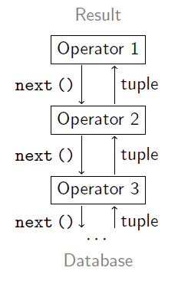
Tuple-At-A-Time Processing
Most systems implement the Volcano iterator model:
Operators request tuples from their input using next ().
Data is processed tuple at a time.
Each operator keeps its own
state.

Slide 40
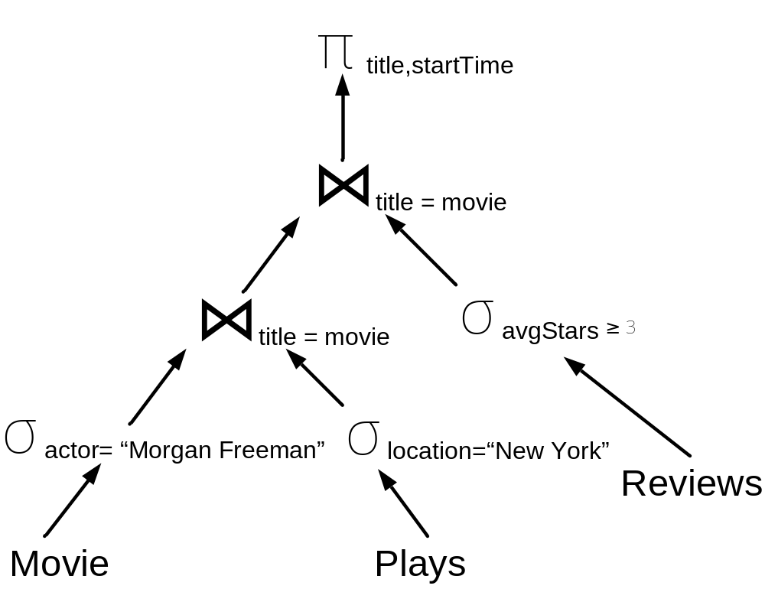
Example Logical Query Plan (revisit Lecture 7)
SELECT title, startTime
FROM Movie M, Plays P, Reviews R
WHERE M.title = P.movie AND M.title = R.movie AND P.location ="New York " AND M.actor = “Morgan Freeman” AND R.avgStars >= 3
Function call
tuple

Slide 41
Tuple-At-A-Time Processing - Consequences
Pipeline-parallelism
→ Data processing can start although data does not fully reside in main memory
→ Small intermediate results
All operators in a plan run tightly interleaved.
→ Their combined instruction footprint may be large.
→ Instruction cache misses.
Operators constantly call each other’s functionality.
→ Large function call overhead.
The combined state may be too large to fit into caches.
  E.g., hash tables, cursors, partial aggregates.
→ Data cache misses.
Not a good option for in-memory DBMS (especially OLAP DBMS)

Slide 42
Operator-At-A-Time Processing
Operators consume and produce
full tables.
Each (sub-)result is fully materialized (in memory).
No pipelining (rather a sequence of statements).
Each operator runs exactly once.
Result
Operator 1
 | tuples
Operator 2
 | tuples
Operator 3
 | tuples
· · ·
Database

Slide 43
Example Logical Query Plan (revisit Lecture 7)
SELECT title, startTime
FROM Movie M, Plays P, Reviews R
WHERE M.title = P.movie AND M.title = R.movie AND P.location ="New York " AND M.actor = “Morgan Freeman” AND R.avgStars >= 3
Materialized
result

Slide 44
Operator-At-A-Time Consequences
Parallelism: Inter-operator and intra-operator
Function call overhead is now replaced by extremely tight loops that
  conveniently fit into instruction caches,
  can be optimized effectively by modern compilers
Function calls are now out of the critical code path.
No per-tuple field extraction or type resolution.
  Operator specialization, e.g., for every possible type.
  Implemented using macro expansion.
  Possible due to column-based storage.
  Implemented in H-store and VoltDB
  Fine for OLTP.
  What about OLAP?

Slide 45
Vectorized Execution Model
Idea:
Use Volcano-style iteration,
but:
for each next () call return a large number of tuples
→ a so called “vector”
Choose vector size
large enough to compensate for iteration overhead (function calls, instruction cache misses, . . . ), but
small enough to not thrash data caches.
vectors
vectors
vectors

Slide 46
Example Logical Query Plan (revisit Lecture 7)
SELECT title, startTime
FROM Movie M, Plays P, Reviews R
WHERE M.title = P.movie AND M.title = R.movie AND P.location ="New York " AND M.actor = “Morgan Freeman” AND R.avgStars >= 3
Function call
data
chunk

Slide 47
What if larger-than-memory?
Hybrid workload:
  OLAP + OLTP
  Small, frequently updated: “Hot Data” -- OLTP
    News, social activities, posts, fresh data, fast data
    Main Memory
  Large, infrequent updated but support analytical queries: “Cold Data” – OLAP
    SSD, Hard disk
  A comparison with Disk-based systems. Hot vs. Cold.

Slide 48
A vision
Non-volatile memory – storage level memory
  Same read/write speed as DRAM
  Persistent guarantee of SSD
High-speed DRAM networks & Systems-on-a-Chip
  Game changer for parallel/distributed algorithm design
In-memory Data Analytics Systems
  Big Data in your laptop!

Slide 49
Conclusion
Overhead of Disk-based DBMS
  Buffer pool
  Concurrency control
  Locking/latching
In-memory DBMS
  Data organization
  Cache awareness
  Query processing models
What we haven’t talked: Indexing? (T-trees: read:
http://www.vldb.org/conf/1986/P294.PDF)

